Slide 1
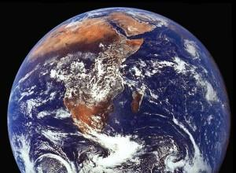
Why Can’t We Build a Biosphere?
NATIONAL CENTER FOR CASE STUDY TEACHING IN SCIENCE
^{by}
^{Kathy K. Gallucci}
^{Department of Biology}
^{Elon University, Elon, NC}

Slide 2
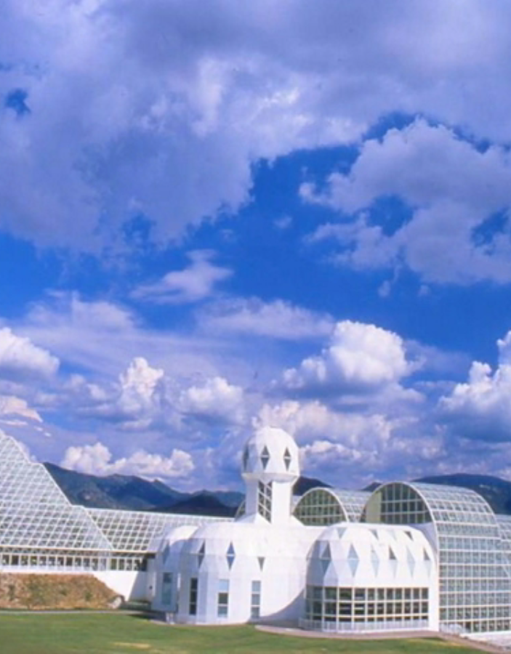
In 1991, four men and four women entered Biosphere 2, a man-made closed ecological system (CES), in Oracle, Arizona. The purpose of this “human experiment” was to see if the eight biospherians could be sustained by this miniature version of Biosphere 1, for two years with no outside support of any kind. If the project was successful, Biosphere 2 might serve as a prototype for a human habitat on Mars, or a retreat for humans on Biosphere 1 during a crisis.
The experiment failed.
Why did it fail?

Slide 3
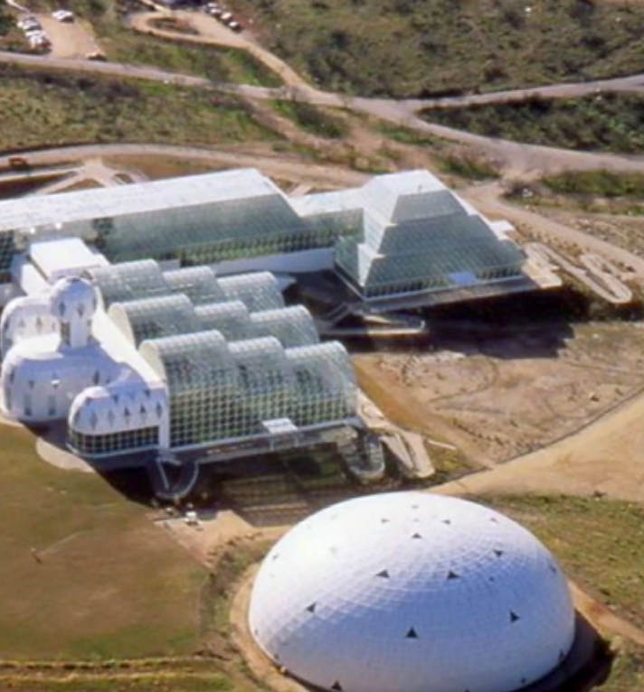
Part I - Biosphere 2

Slide 4
Discussion Question 1
What would you need to build a biosphere?
How can the biosphere be constructed?
  What supporting services would you include?
How would the services be controlled?
  What regulating services would you include?
What provisioning ecosystem services are needed?
  How can these be sustained in a biosphere?
What cultural ecosystem services would help enrich the lives of biospherians?

Slide 5
On 3.14 acres, Biosphere 2 had:
3800 species
five biomes
an agricultural area
a “technosphere”
living quarters

Slide 6
Discussion Question 2
What kinds of organisms would you select for your biosphere?
Discussion Question 3
What utilities would you need to include in the
“technosphere”?
Notes:
energy (sunlight)
soil structure
wind
temperature modulation
water

Slide 7
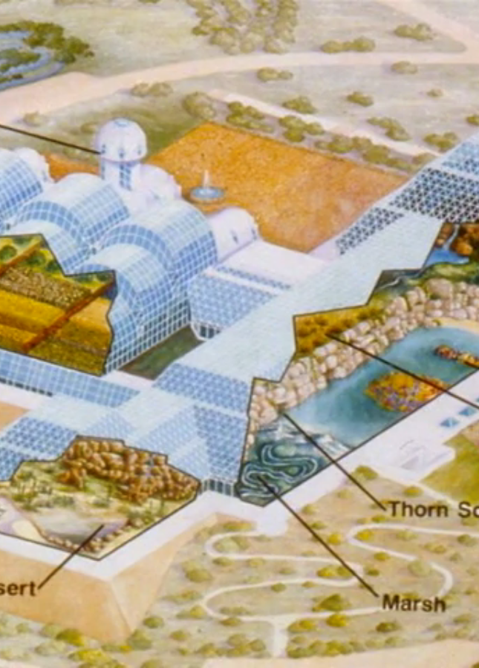
a rainforest
an ocean, with a coral reef
a fog desert
a mangrove swamp
a savannah grassland
an agricultural area
a “technosphere”
living quarters with a library

Slide 8
Comparison of Biosphere 1 and 2
 | Biosphere 1 | Biosphere 2
location | Earth, Solar System | Oracle, AZ
footprint | 126 billion acres | 3.14 acres
biomes | 13 wilderness biomes | 5 wilderness biomes
species | 10 – 40 million | 3800
population | 6.8 billion humans | 8 humans
energy source | sun, fossil fuel | sun, fossil fuel
age | 3.5 billion years BP | 18 years BP
enclosure | magnetic field and gravity | glass & steel skin, gravity
cost | “free” | $200 million (initial)
(Poynter TED Talk, 2009; Cohen & Tilman, 1996)

Slide 9
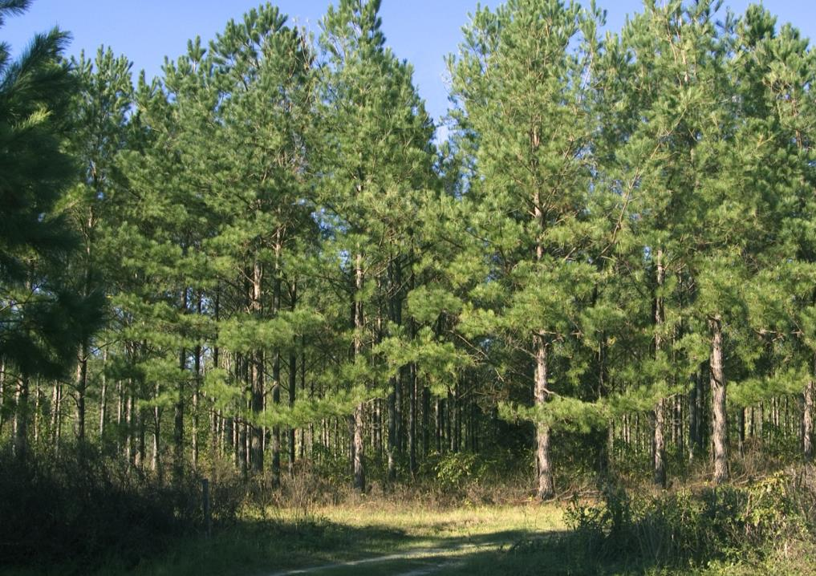
Part II - Ecosystem Services

Slide 10
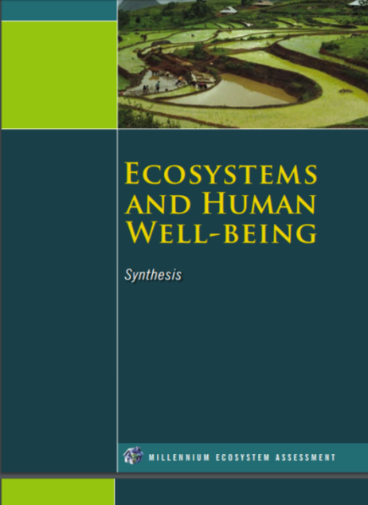
Millennium
Ecosystem
Assessment
United Nations
2005
(Millennium Ecosystem Assessment)
Notes:
The Millennium Ecosystem Assessment was completed by the United Nations in 2005. According to its Synthesis Report, “the objective…was to assess the consequences of ecosystem change for human well-being and to establish the scientific basis for actions needed to enhance the conservation and sustainable use of ecosystems and their contributions to human well-being.”

Slide 11
Supporting
Provisioning
Regulating
Cultural
Notes:
These supporting ecosystem services are necessary for the production of the other services. The Millennium Ecosystem Assessment explains that supporting services differ from provisioning, regulating, and cultural ecosystem services in that their impacts on people are often indirect or occur over a very long period of time.

Slide 12
Discussion Question 4
What ecosystem services of Biosphere 1 must be recreated in Biosphere 2?

Slide 13
Provisioning
food, water, protection, energy, medicine,
genetic resources
Supporting
  photosynthesis
  oxygen production
  nutrient cycling
  water cycling
  soil formation
Regulating
water filtration, carbon storage, flood, disease, and erosion control,
hazard protection
Cultural
spiritual solace, recreation, education, heritage, tourism, aesthetics, inspiration

Slide 14
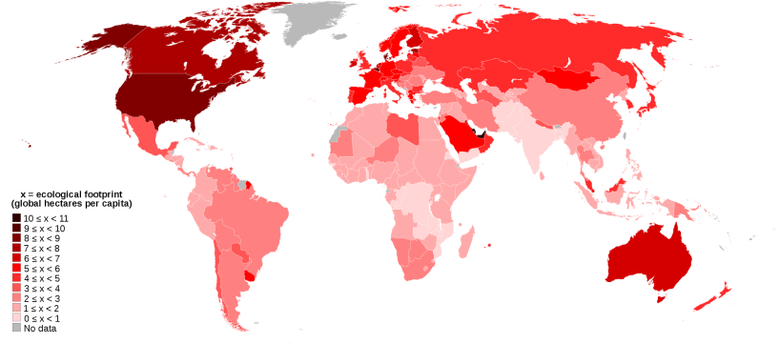
Part III - The Ecological Footprint
Notes:
wikipedia.org

Slide 15
Ecological Footprint
How many planets does it take to support your lifestyle?
http://www.earthday.org/footprint-calculator

Slide 16
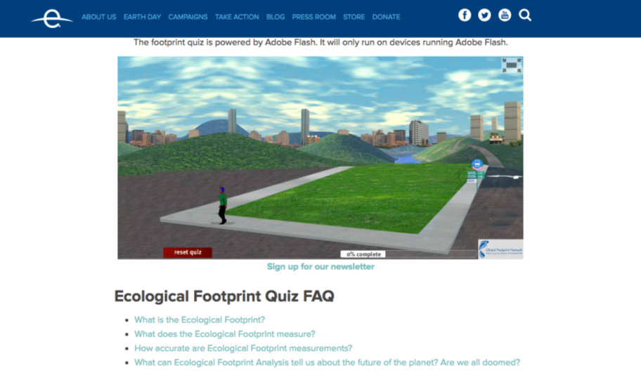
Notes:
screen shot of http://www.earthday.org/footprint-calculator

Slide 17
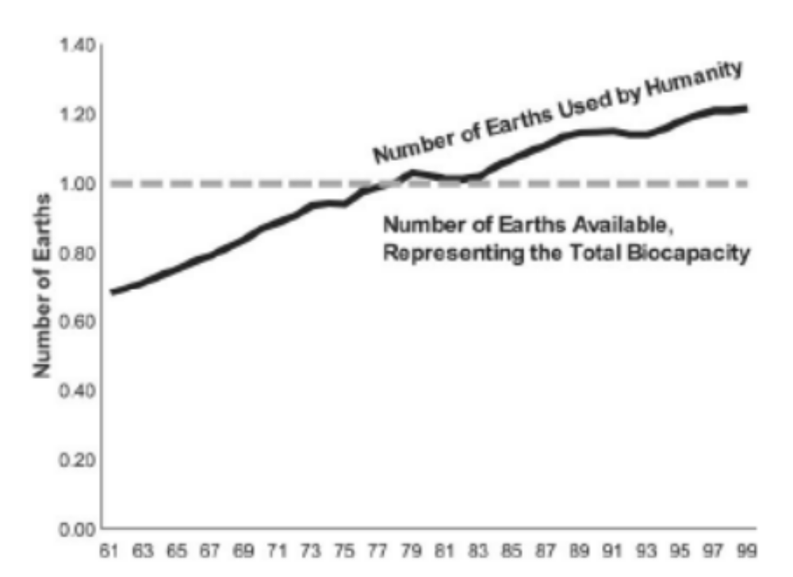
Number of Earths Required to Sustain Humanity
(Wackernagel, et al., 2002)

Slide 18
Discussion Question 5
How can the overreach of an individual’s ecological footprint inform us about the ecosystem services required by Biosphere 2? Why did Biosphere 2 fail?

Slide 19
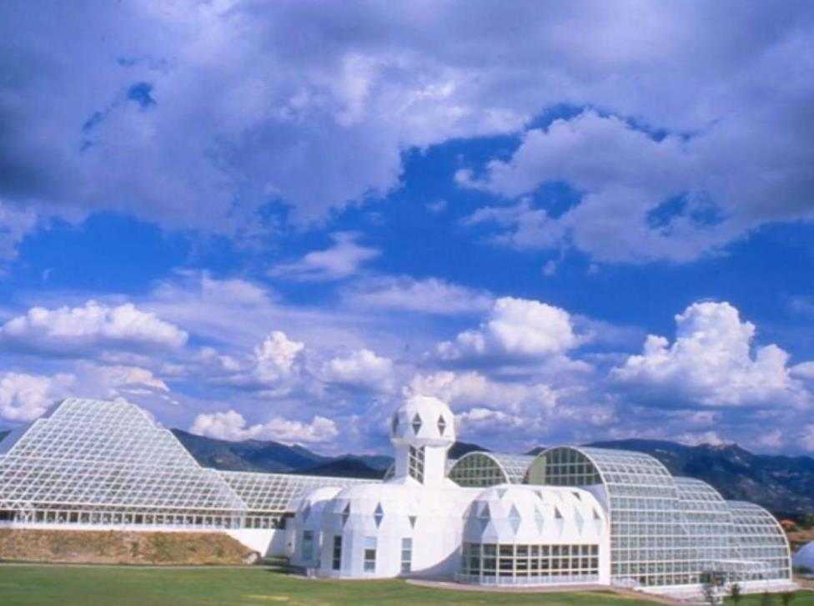
(Cohen, J.E. & D. Tilman, 1996)
“The major retrospective conclusion that can be drawn is simple. At present, there is no demonstrated alternative to maintaining the viability of Earth. No one knows how to engineer systems that provide humans with the life-supporting services that natural ecosystems produce for free.”

